Slide 1


Slide 2
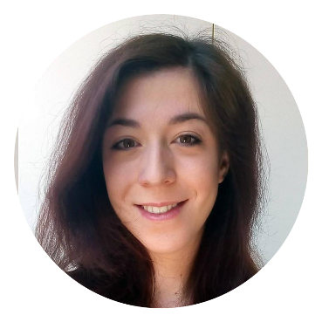
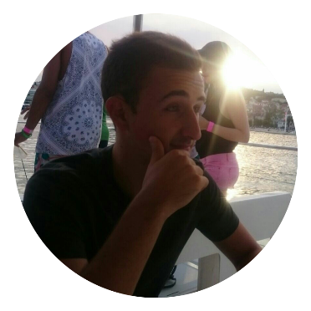

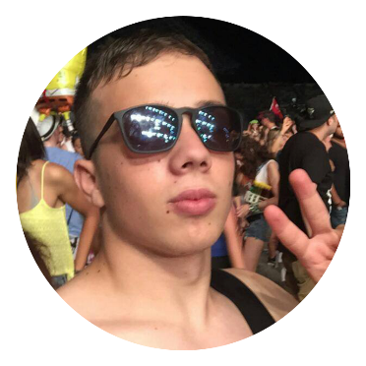
Team
Andrea
Petar
Front-end dev
Front-end dev
Matej
Bartul
Designer
Back-end dev

Slide 3

Where is problem?

Slide 4
Problem
3.2 B
2.7 B
2.2 B
1.7 B
Teens use internet
Love messaging
People on internet
99%
51%
3.2 BILLION
BIG SOCIAL PROBLEM

Slide 5
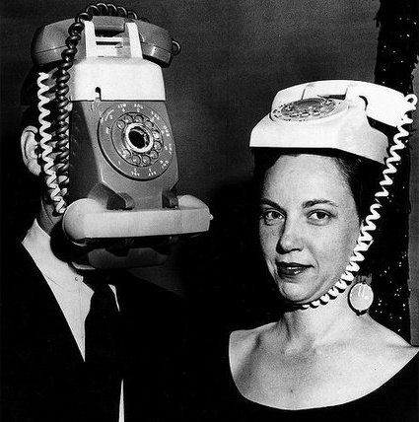

Slide 6

Solution?

Slide 7
Solution
Better comunication in real world
Great idea
Fun, comunication, education

Slide 8

How it works?

Slide 9
How it works?
T
GUY FROM TEAM A WINS
TEAM A
TEAM B

Slide 10





Technology

Slide 11

Demo

Slide 12

Thank you!

Slide 13

Any questions?

